Slide 1

Leading with Sovereignty: Advancing Native Education for the Future of Our Nations
Native Education in Practice, Policy, and Partnership
Jason P Dropik, (Bad River Ojibwe)
Executive Director
National Indian Education Association

Slide 2

About NIEA
Mission Statement
The National Indian Education Association advances comprehensive, culture-based educational opportunities for American Indians, Alaska Natives, and Native Hawaiians.
Our Purpose
NIEA advocates for policies and creates programs that support self-determination and the development of comprehensive culturally-grounded learning opportunities for Native students. By empowering the capacity for self-determination, our communities gain the skills, knowledge, and voice to nurture the strengths, resilience, and intelligence of our Native youth grounded in traditional Native ways.
Learn more about our work at niea.org

Slide 3
The Educational Landscape
School Type
Governance
Who to Know
Public Schools
State / Local
Title VI coordinators, JOM committees
BIE Schools
Federal/Tribal
School leadership, school boards
Tribally controlled / grant schools
Tribal Education Departments
Tribal
Private/parochial
Independent
School leadership, tribal liasons
  Over 90% of Native students attend public schools

Slide 4
Barriers and Challenges
Barriers to equitable education for Native students exist across three domains:
Community: language loss, rural access, economic opportunity
School Systems: lack of Native representation, funding gaps, curriculum erasure
Individual / Family: intergenerational trauma, mental health, cultural identity

Slide 5
Tribes are Nations
  Native peoples and governments have inherent rights and a political relationship with the U.S. government that does not derive from race or ethnicity.
  Federally recognized American Indian and Alaska Native Tribal Nations have a government-to-government relationship with the two other sovereign governing bodies of the United States.
Federal
Government
American Family of Governments
States
Tribal Nations
Source: Tribal Nations and the United States: An Introduction, National Congress of American Indians. https://archive.ncai.org/about-tribes

Slide 6

Education is one of the greatest acts of nation-building.
Every classroom is an opportunity to strengthen a people, a language, and a future.
National Indian Education Association

Slide 7
Policy & Advocacy Work
NIEA is committed to advocating for policies that support Native students’ academic success and respect tribal sovereignty. This section will cover our efforts to monitor and respond to federal actions, highlight key legislative priorities, and emphasize the importance of culturally relevant education.
FEDERAL LEVEL
OUR POLICY PRIORITIES
At the federal level, NIEA works directly with key departments and agencies, including:
  U.S. Department of Education: Engaging in policy development and monitoring funding streams like Title VI and Johnson-O’Malley programs.
  Bureau of Indian Education (BIE): Collaborating on improvements for BIE schools and ensuring federal funding supports Native students.
  U.S. Congress & Senate: Building relationships with lawmakers to push for funding increases and legislative protections for Native students and educators.
Federal Policy & Legislative Priorities – Advocating for policies and funding that directly impact Native education.
Tribal Sovereignty in Education – Strengthening tribal control over education systems to reflect Native values and traditions.
Monitoring Federal Policy & Administration Updates – Tracking key executive orders, legislative changes, and federal agency actions that impact Native education, while advocating for policies that uphold tribal sovereignty and support Native students.

Slide 8
State & Tribal
Policy Work
TRIBAL LEVEL
STATE LEVEL
NIEA supports Tribal sovereignty through strong Tribal Education Departments and Native-led education. This includes:
  Protect Tribal Sovereignty
  Advance Tribal Consultation
  Invest in Tribal Education Systems
NIEA also works with state-level departments of education to ensure that Native education priorities are embedded in state policies. This includes advocating for:
  Build State Leadership
  Influence State Policy
  Expand Native Education Funding

Slide 9
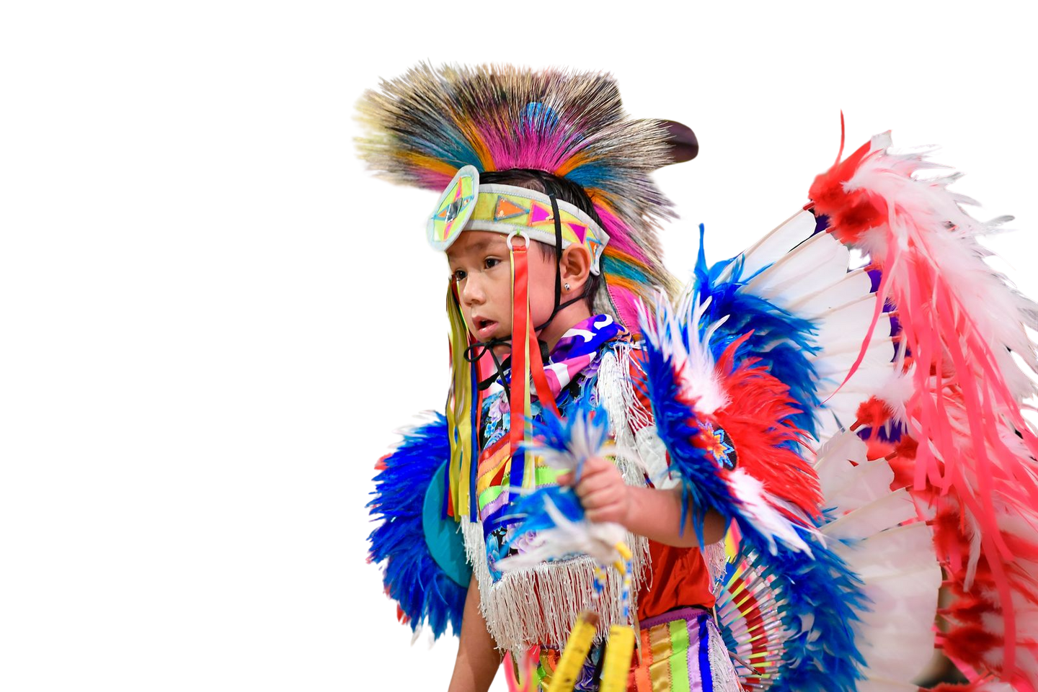
FEDERAL POLICY
Updates
US Department of Education, Bureau of Indian Educations, and Other Administrative Actions
National Indian Education Association

Slide 10
Updates
  Interagency Agreements Department of Education Transfers
    This is happening-OIE is being supported by BIE, though not a full transfer
    ED emails are still the contact for these programs
    Communicate with NIEA w/any concerns or questions
  Appropriations-House subcommittee passed
    House Bill 13.3% increase, increase proposed in ISEP, JOM, and TCUs, decrease in construction and some accounts unknown

Slide 11
Updates-Continued
  BIE Construction (GAOA 250 or HR 9250)
    June 17th passed in senate committee, less than week later house passed as well. Both include 5% set aside for BIE deferred maintenance, approximately $95 million each year
  Indian Professional Development Grant Program
    Non LEAs are eligible for the PD program; the Department of Ed, uses state statutory definition of an LEA
  Indigenous Students Excel through Parity Act

Slide 12
Federal Advocacy
RESOURCES
  NIEA Statements
  Fact Sheets
  Talking Points
  Letter Templates
  Tribal Resolution Templates
https://www.niea.org/administration-updates
echastain@niea.org Legislative and Federal Policy Director
rTwoBulls@niea.org Legislative and Federal Policy Analyst

Slide 13
NIEA wants to hear
YOUR STORIES
  Examples of relevant updates include:
  Staffing changes
  Program cancellations
  Funding impacts
  Tribal resolutions
  State or federal legislative actions
  Other key developments affecting Native education
Share How Policy Decisions Affect Your Community
📩 Email me at jdropik@niea.org to share your updates.
National Indian Education Association

Slide 14
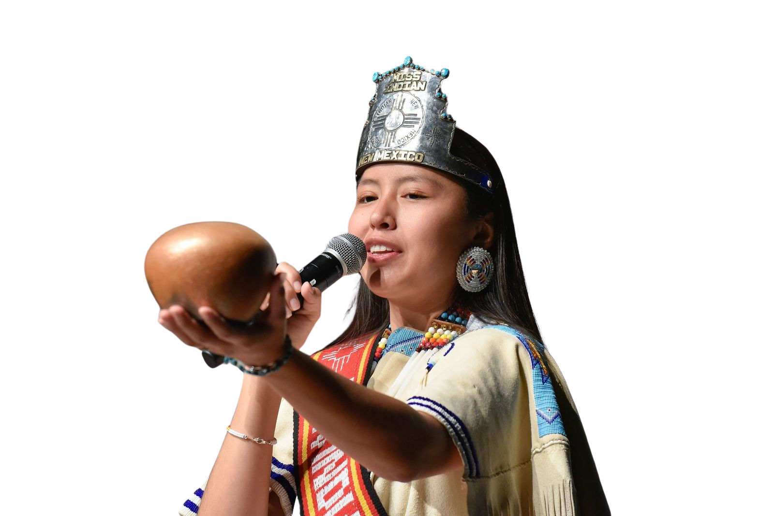
Miigwech (Thank You)
The future of our Nations will not be decided by the policies we write alone, but by the children who know who they are because of the education we choose to build together.
Stay connected with us at niea.org
Notes:
Jason/Casie

